Slide 1
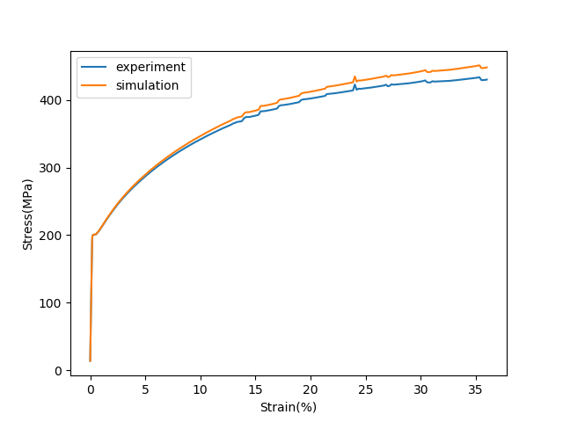
GA-Calibration Tool
After the RVE construction, material crystal plasticity parameters calibration is necessary for accurate numerical simulations.
Objective: To minimize the deviation between simulation-based results and experimental results.
Challenges: Calibration is a complex, multidimensional optimization problem(mutli-phase material, many parameters).
Methodology: Genetical algorithm is a powerful tool to solve such optimization problem.
Deviation
Simulation and Experiment Stress-Strain Curve

Slide 2
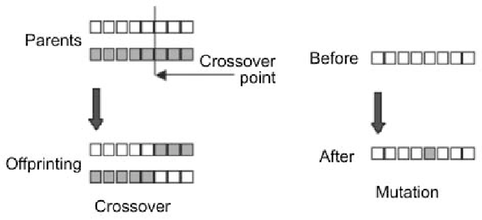
GA-Calibration Tool
Genetical Algorithm(GA): Inspired by the principles of natural evolution.
The solution to an optimization problem is optimized by 3 operations: selection, mutation, and crossover.
Notes:
Each trial material properties set is regarded as DNA of a solution.
The performance in the task(minimize the deviation) is evaluated.
Several best DNAs are selected(selection).
Then new “child” DNAs are produced from “parent” DNAs by:
Mutation: random vibration of some parameters in trial material properties set.
Crossover: recombination of several “parent” material properties set.

Slide 3
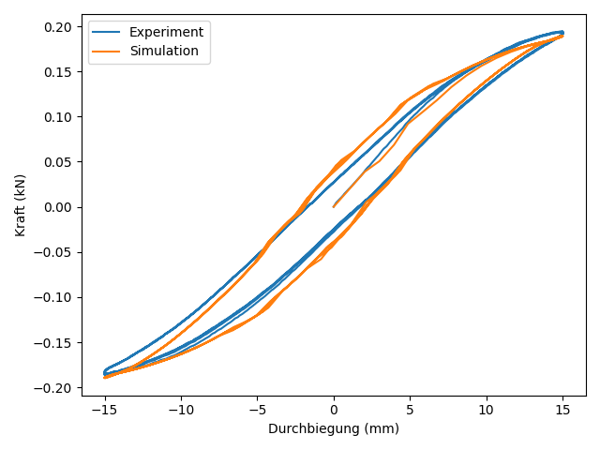
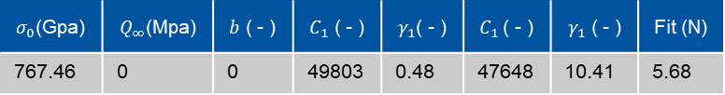
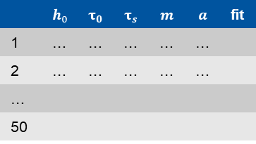
GA-Calibration Tool
DNA
 | $$h_{0}$$ | $$τ_{0}$$ | $$τ_{s}$$ | $$m$$ | $$a$$ | fit
1 | … | … | … | … | …
2 | … | … | … | … | …
…
50
$σ_{0}$(Gpa) | $Q_{∞}$(Mpa) | $b$ ( - ) | $C_{1}$ ( - ) | $γ_{1}$( - ) | $C_{1}$( - ) | $γ_{1}$ ( - ) | Fit (N)
767.46 | 0 | 0 | 49803 | 0.48 | 47648 | 10.41 | 5.68
Crossover and mutation of DNA
Initial Population
Find best individual
Individual
 | $$h_{0}$$ | $$τ_{0}$$ | $$τ_{s}$$ | $$m$$ | $$a$$ | fit
1 | … | … | … | … | …
2 | … | … | … | … | …
…
50
Individuen
New generation
Termination criterion
Final Individual
Notes:
Each trial material properties set is regarded as DNA of a solution.
The performance in the task(minimize the deviation) is evaluated.
Several best DNAs are selected(selection).
Then new “child” DNAs are produced from “parent” DNAs by:
Mutation: random vibration of some parameters in trial material properties set.
Crossover: recombination of several “parent” material properties set.

Slide 4
GA-Calibration Tool
GA-Calibration Tool: User-friendly, Efficient, Powerful.
The tool is being developed based on RWTH HPC cluster（high computation time required).
This tool supports:
Automatical and cocurrent submission of simulation jobs
Single or dual phase material calibration
Abaqus or DAMASK (MOOSE support to be implemented)
uniaxial tensile test, cyclic test or Chaboche test

Slide 5
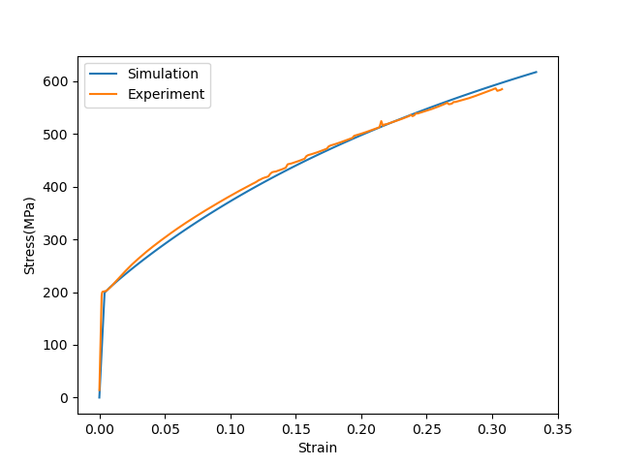
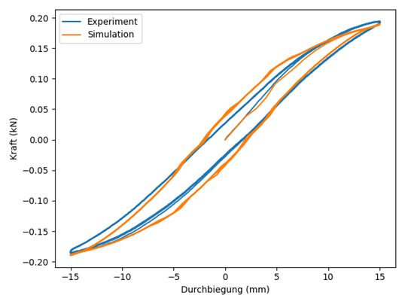
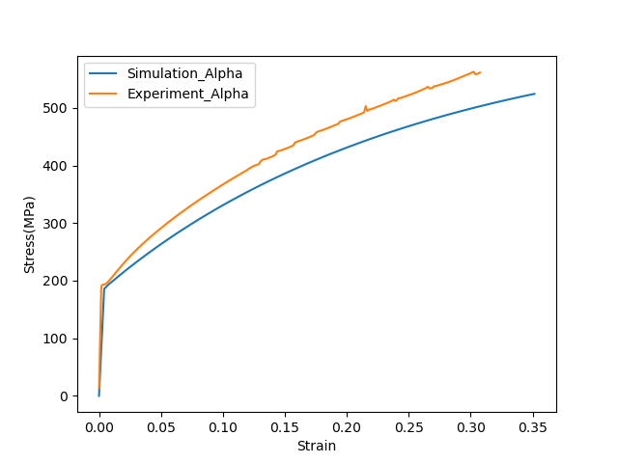
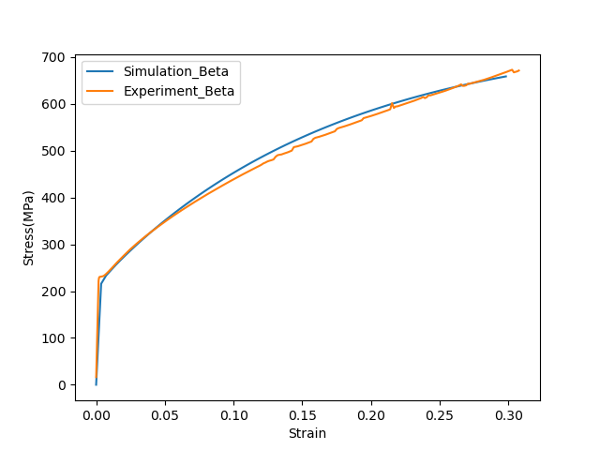
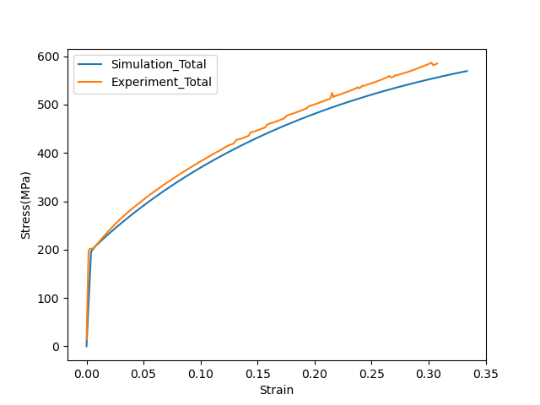
GA-Calibration Tool
The comparison of experimental results and simulation results:
Alpha Phase Brass, Beta Phase Brass, Total Sample
The comparison of experimental results and simulation results:
Single phase uniaxial tensile test,single phase cyclic test
Notes:
The calibration results of single phase and dual phase material, the simulation results show good agreement with experimental results. And it only costs about 3 days to obtain such good reuslts.

